Slide 1
Rosey Flow
The period is the worst punctuation

Slide 2

The Creators
Why Rosey Flow?

Slide 3
Our Mission
To allow women to make the most of their flow

Slide 4
Functions of Rosey Flow
01
02
03
04
Information
Cycle Tracking
Informative texts to help with each stage of your cycle
Texts to help you track your cycle
Women’s Mental Health
Justification
Promotion of women’s mental health through information
Just because you’re “hormonal” does not make your emotions any less real

Slide 5
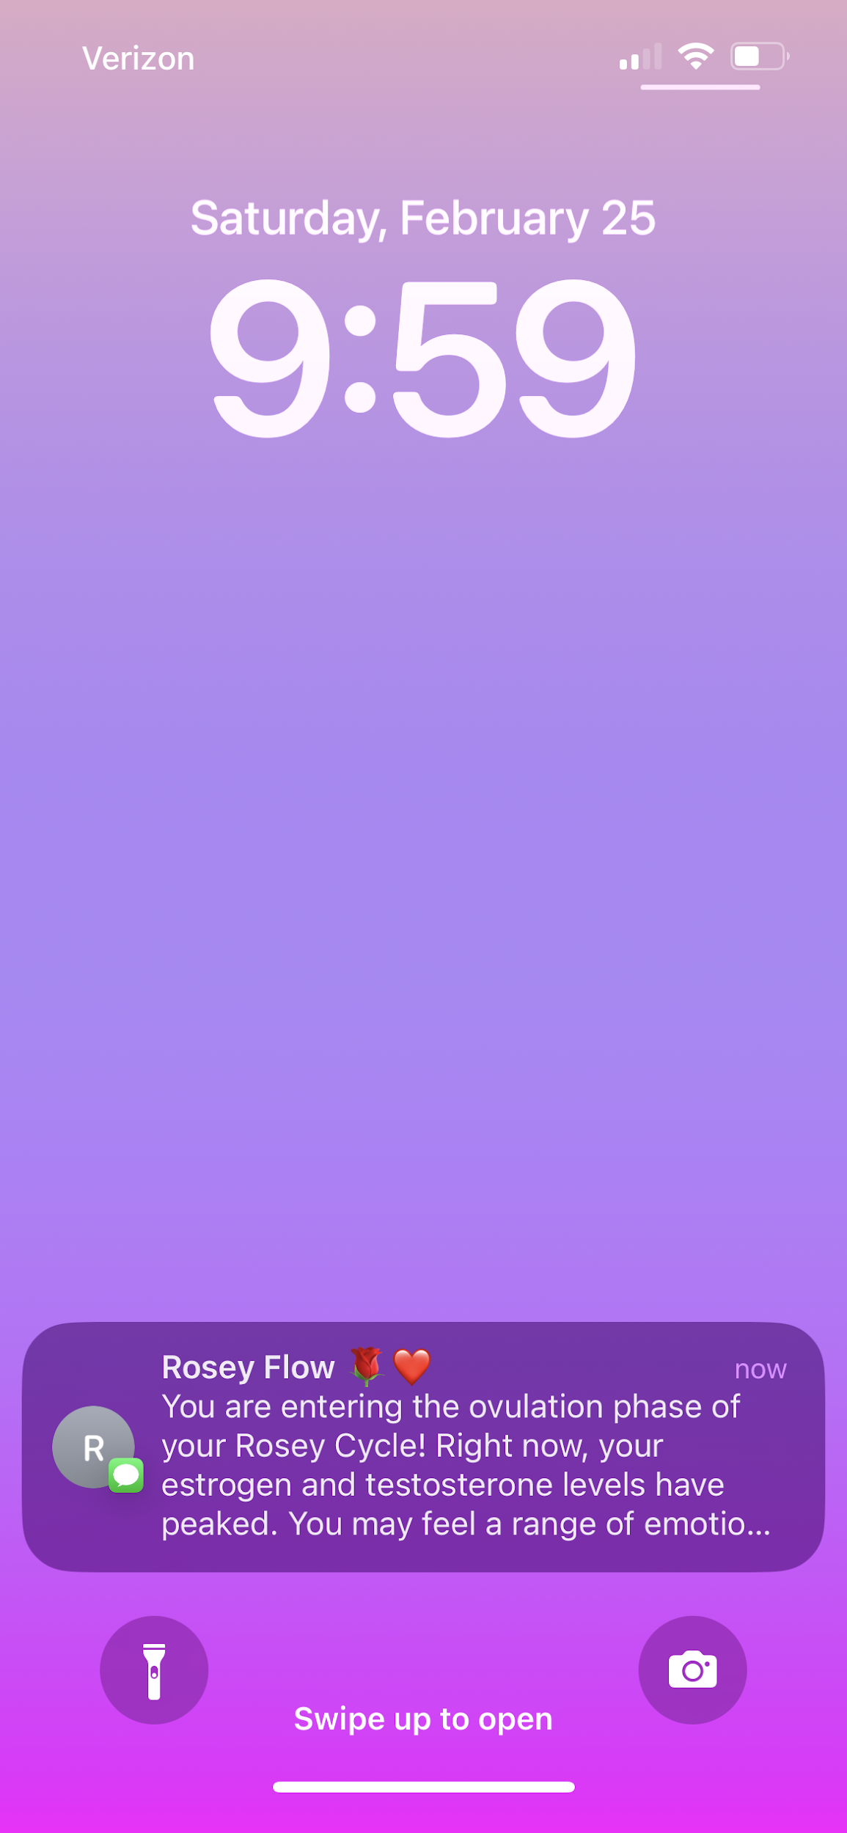
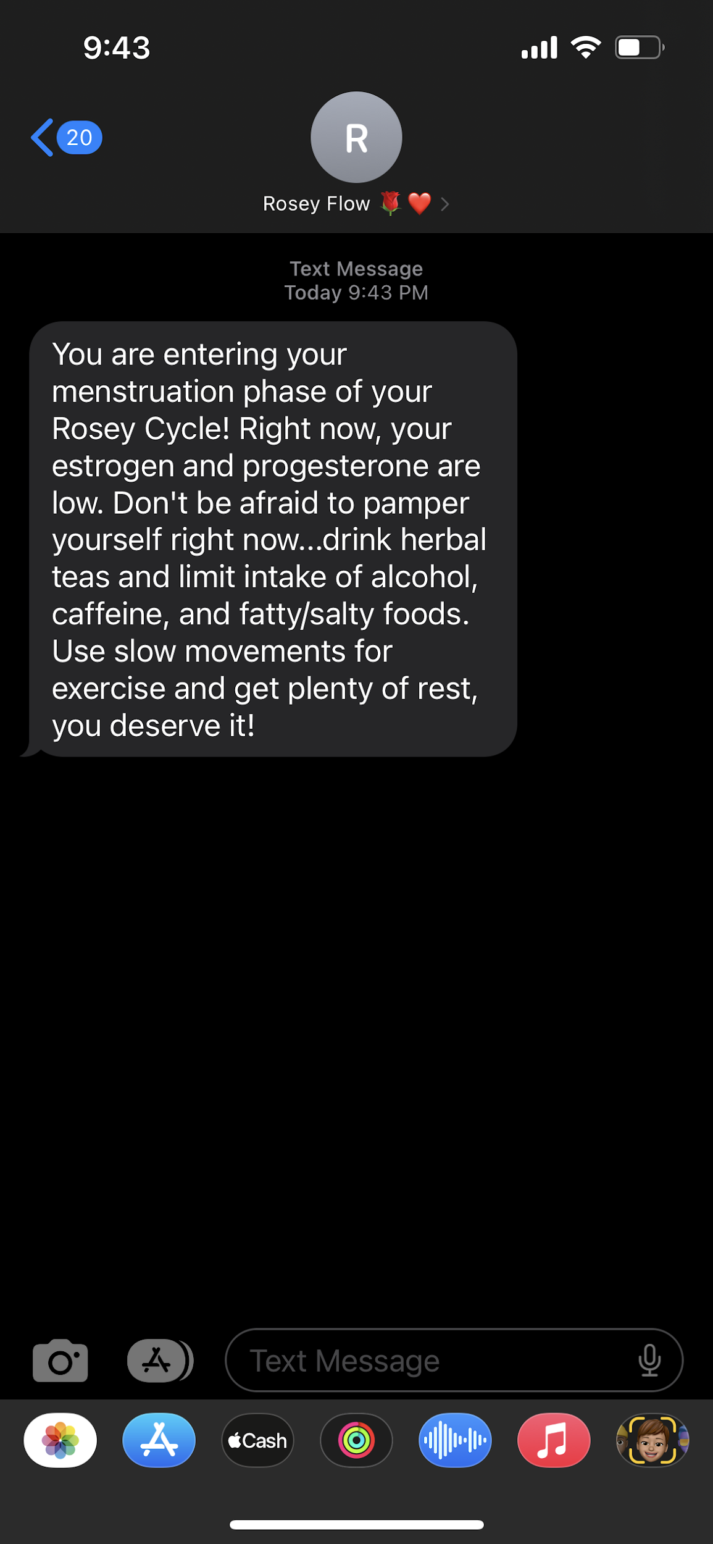

How it Works
Join the SMS services to through our website to receive updates and information regarding your menstruation cycle.

Slide 6

Our Demo
https://github.com/diyavij/roseyflow

Slide 7
Vision
We want to reach women on a national level and provide information to everyone regarding the truth behind hormones

Slide 8

Our Future
New Features
Chat forums will allow fellow users to connect and build a community based around menstruation
An integrated calendar to schedule based on what’s best for you
Opt-in period joke of the day
Opt-in affirmations based on your cycle phase
What’s an ovary’s favorite type of TV show?
Period Dramas B)

Slide 9
―Tracy Lockwood
Society has placed a taboo surrounding periods and menstrual health as if we should be ashamed of this natural and miraculous process that ultimately kept the human species alive.

Slide 10
Join the tide of women taking back their month!
Remember: there are more to punctuation marks than the period
Instagram: @roseyfl0w

Slide 11
Sources
https://drbrighten.com/how-hormones-affect-mood-throughout-menstrual-cycle/
https://www.healthline.com/health/womens-health/guide-to-cycle-syncing-how-to-start#_noHeaderPrefixedContentn
https://www.womenh.com/22-menstruation-quotes-to-help-you-embrace-your-periods/
https://www.everydayhealth.com/womens-health/how-your-menstrual-cycle-affects-your-behavior.aspx
https://www.scarymommy.com/period-jokes

